Slide 1
Scaling Techniques and Topic Modeling
Prof. Sebastián Vallejo Vera

Slide 2
This week, we will go through the readings after this lecture, since the lecture reviews the techniques proposed (or applied) by the readings.

Slide 3
Changing our focus…
So far, we have been obsessing over tokens (e.g., frequency, dictionaries, complexity) as observable manifestations of concepts. Now we turn to measures that:
Position texts in vector space
Derive measures of n latent dimensions based on attributes of j documents:
For example, ideological placement of parliamentarians based on what they say on the floor.
For example, bias of newspapers using text from editorials.

Slide 4
Two main ways to scales text:
Supervised scaling techniques
Unsupervised scaling techniques

Slide 5
Supervised scaling techniques

Slide 6
Laver et al.’s (2003) Wordscores
Note: We will have a dedicated week on supervised learning more broadly. The intuition is the same, so this is a good primer.
Wordscores uses reference documents with known or assumed positions (the equivalent of a training set) to score virgin documents.

Slide 7
The process is as follows:
We give each reference text r an a priori score A.

Slide 8
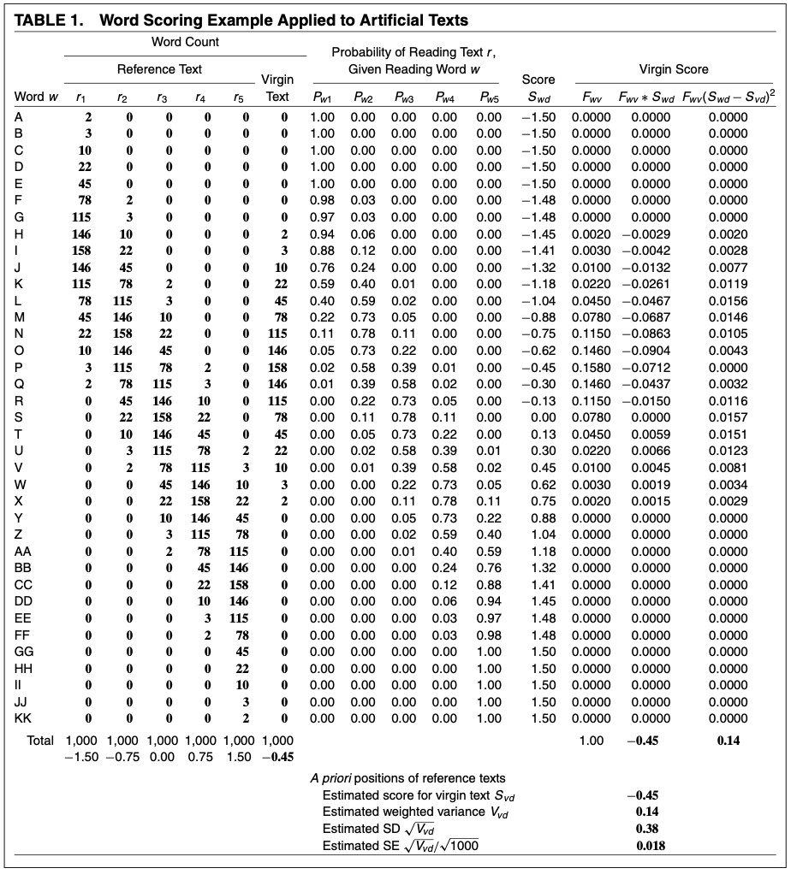
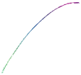

Slide 9
The process is as follows:
We give each reference text r an a priori score A.
We count the number of words w that occur in reference text r.

Slide 10
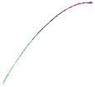

Slide 11
The process is as follows:
We give each reference text r an a priori score A.
We count the number of words w that occur in reference text r.
We estimate the probability P of reading text r, given word w.

Slide 12
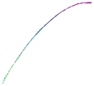

Slide 13
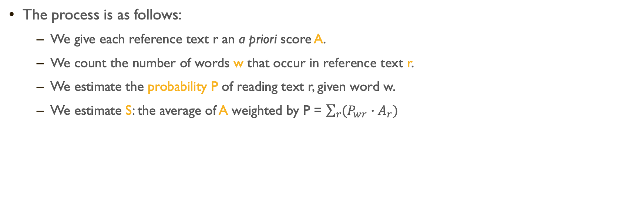
The process is as follows:
We give each reference text r an a priori score A.
We count the number of words w that occur in reference text r.
We estimate the probability P of reading text r, given word w.
We estimate S: the average of A weighted by P = $\sum_{r}{(P_{wr}}∙A_{r})$

Slide 14
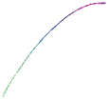

Slide 15
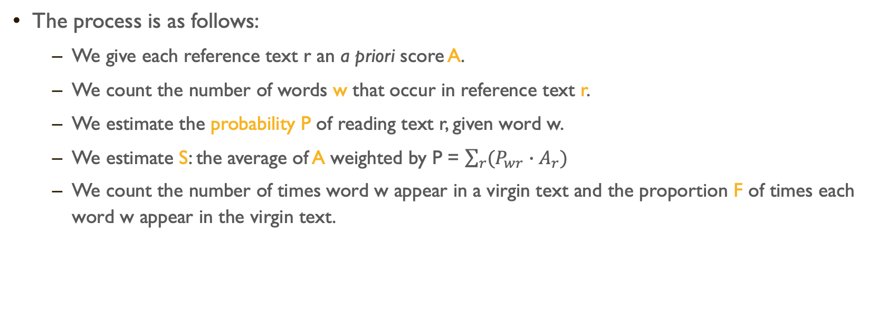
The process is as follows:
We give each reference text r an a priori score A.
We count the number of words w that occur in reference text r.
We estimate the probability P of reading text r, given word w.
We estimate S: the average of A weighted by P = $\sum_{r}{(P_{wr}}∙A_{r})$
We count the number of times word w appear in a virgin text and the proportion F of times each word w appear in the virgin text.

Slide 16
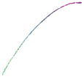

Slide 17
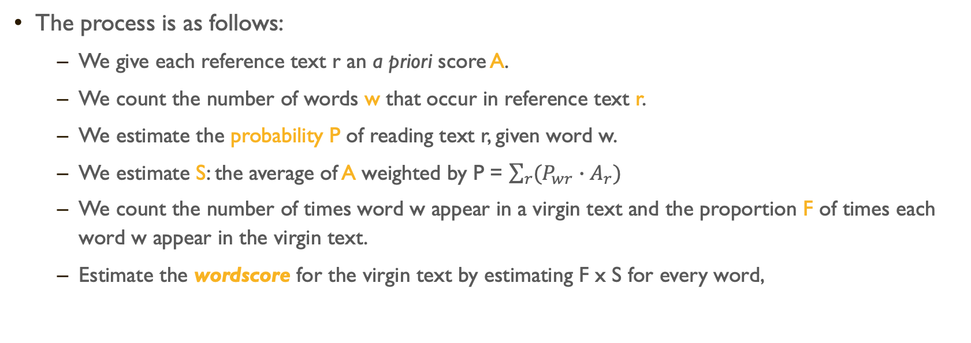
The process is as follows:
We give each reference text r an a priori score A.
We count the number of words w that occur in reference text r.
We estimate the probability P of reading text r, given word w.
We estimate S: the average of A weighted by P = $\sum_{r}{(P_{wr}}∙A_{r})$
We count the number of times word w appear in a virgin text and the proportion F of times each word w appear in the virgin text.
Estimate the wordscore for the virgin text by estimating F x S for every word,

Slide 18
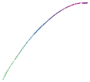

Slide 19
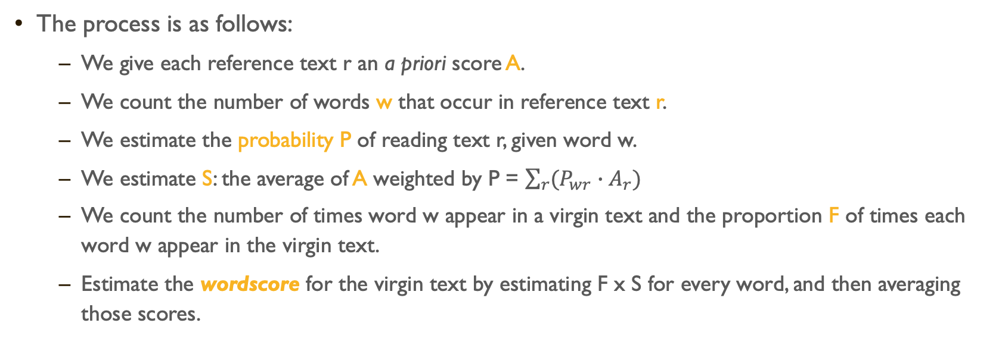
The process is as follows:
We give each reference text r an a priori score A.
We count the number of words w that occur in reference text r.
We estimate the probability P of reading text r, given word w.
We estimate S: the average of A weighted by P = $\sum_{r}{(P_{wr}}∙A_{r})$
We count the number of times word w appear in a virgin text and the proportion F of times each word w appear in the virgin text.
Estimate the wordscore for the virgin text by estimating F x S for every word, and then averaging those scores.

Slide 20


Slide 21
That way we can put the virgin text in a dimension relative to the reference words.
And this seems to work:

Slide 22
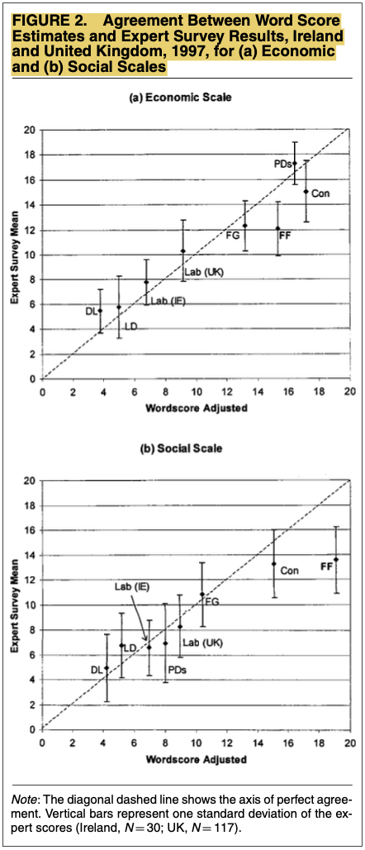

Slide 23
There are some methodological issues (see Slapin and Proksch 2008):
Technique doesn’t recover estimates of “virgin” texts on same scale as reference texts (see Martin and Vanberg 2008)
Difficult to find reference texts + appropriate a priori measures of document-level ground truth positions
Cannot be straightforwardly used for estimates of over-time variation

Slide 24
Unsupervised scaling models

Slide 25
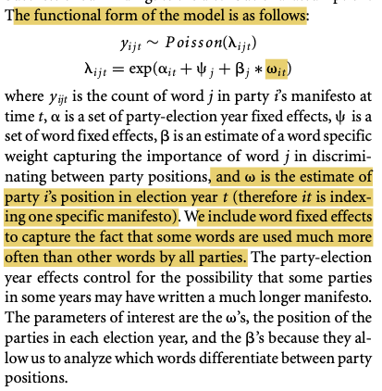
Slapin and Proksch’s (2008) wordfish
⍺ is the logged ratio of the mean word count for a document relative to first document in the data.
ψ is the logged mean of word frequency.

Slide 26
The assumption here is that, indeed, λ is generated by the parameters proposed by Slapin and Proksch (2008).
For example, that β is good at discriminating documents across an a priori assumed dimension:

Slide 27
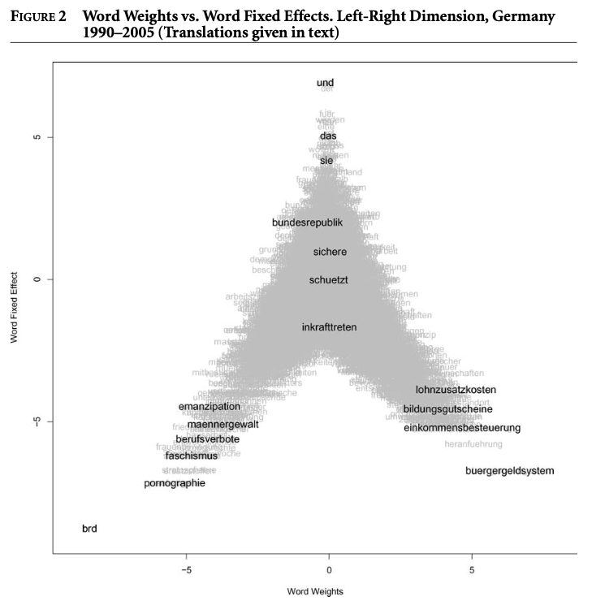

Slide 28
(Unsupervised) Topic Models

Slide 29
Roberts et al.’s (2014) Structural Topic Models
Topic models are a broad class of Bayesian generative models that encode problem-specific structure into an estimation of categories (Grimmer and Stewart 2013; Blei et al. 2010).
Statistically, a topic is a probability mass function* over words.
The idea of topic models is that each document exhibits a topic in some proportion: each document is a distribution over topics, and each topic is a distribution over words.
* Same as a PDF but for discrete random variable

Slide 30
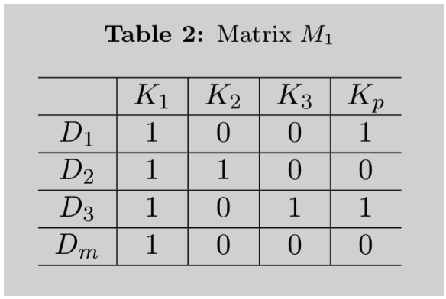

Take a matrix $M_{1}$ such that:
$m$documents: $D_{1},$ $D_{2},$ $D_{3},$ …, $D_{m}$
$p$ topics: $K_{1},$ $K_{2},$ $K_{3},$ …, $K_{p}$

Slide 31
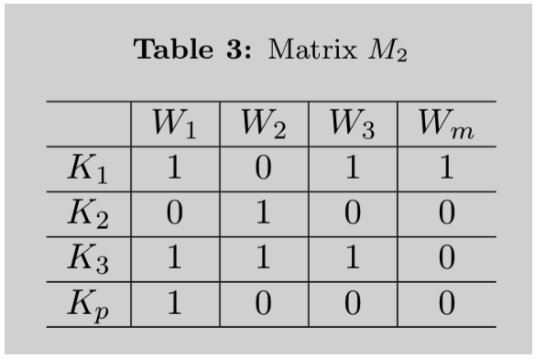

Take a matrix $M_{2}$ such that:
$n$words: $W_{1},$ $W_{2},$ $W_{3},$ …, $W_{n}$
$p$ topics: $K_{1},$ $K_{2},$ $K_{3},$ …, $K_{p}$

Slide 32
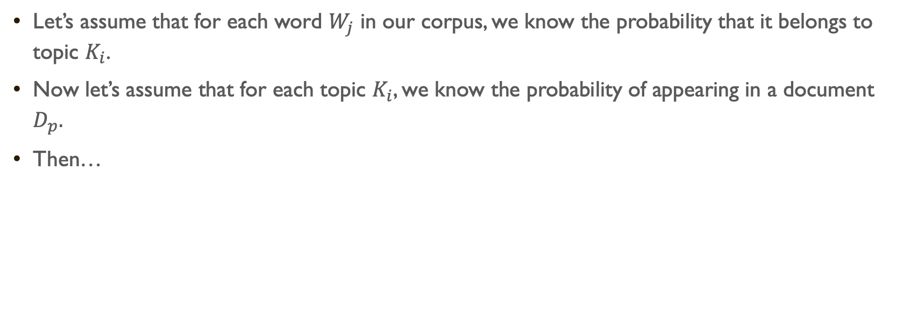
Let’s assume that for each word $W_{j}$ in our corpus, we know the probability that it belongs to topic $K_{i}$.
Now let’s assume that for each topic $K_{i}$, we know the probability of appearing in a document $D_{p}.$
Then…

Slide 33

X
=
$$dtm$$

Slide 34
BUT…
We need to estimate the probability a word comes from a topic
We need to estimate the probability a topic appears in a document
By only observing words and documents.
And our only input is the number of topics we ask the model to finds
HOW?
Variational inference of variational Bayes inference

Slide 35
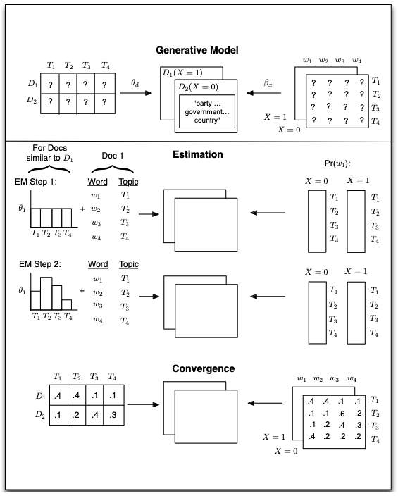

Slide 36

Intuitively, we define a data generating process for each document and then use the data to find the most likely values for the parameters within the model.
The generative model begins at the top, with document-topic and topic-word distributions generating documents that have metadata associated with them ($X_{d}$, where d indexes the documents).

Slide 37

A topic is defined as a mixture over words where each word has a probability of belonging to a topic.
A document is a mixture over topics, meaning that a single document can be composed of multiple topics.

Slide 38
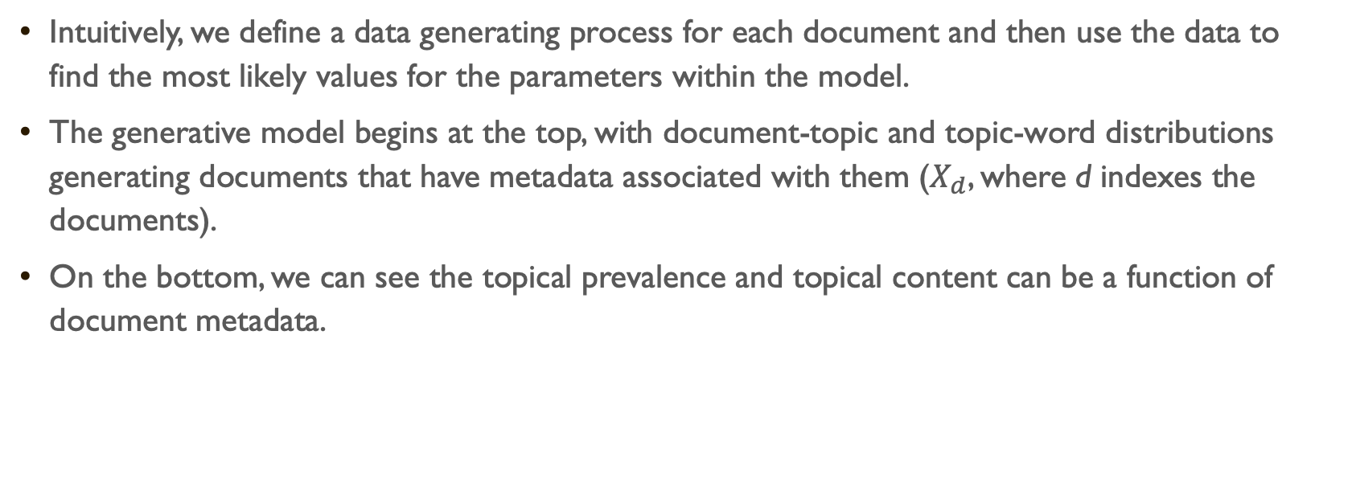
Intuitively, we define a data generating process for each document and then use the data to find the most likely values for the parameters within the model.
The generative model begins at the top, with document-topic and topic-word distributions generating documents that have metadata associated with them ($X_{d}$, where d indexes the documents).
On the bottom, we can see the topical prevalence and topical content can be a function of document metadata.

Slide 39



Document metadada
Topical content refers to the words used within a topic
Topical prevalence refers to how much of a document is associated with a topic

Slide 40
And “that’s it”…
Topic models in general, and STMs in particular, are useful:
Helps us classify large corpora by topics (either known or unknown)
Examples?
Helps discover possible topics (i.e., reverse engineer the topic generating process), particularly helpful when these are partially unknown.
Examples?

Slide 41
Idiosyncratic view on topic models

Slide 42
STM revolutionized the application of computational text-analysis techniques in the social sciences.
There have been, however, important critiques on the instability of the models and the problems with post-hoc decisions made by researchers to accommodate their needs (not Roberts et al.’s fault).
My experience with STM models has been… not good.
More importantly, I believe that the current advancement in transformers-based machine learnings and GPT models can provide better results with the same effort and low cost.

Slide 43
That said, even with my particular idiosyncratic view on the topic (as well as my experience with these models), I also believe that it is important to understand the intuition behind these models (and how to apply them).
So, after what? [look at wrist with no watch] two hours? of whatever this class was? let’s see how to run these beibi!
But, lest I forget:

Slide 44
Today’s Readings
Did the paper answer the research question?
Was the data appropriate for answering that question?
Was the method appropriate for answering that question?
Are the conclusions arrived at by the author supported by `their evidence?

